Slide 1


Chapter 4
Network Layer
Computer Networking: A Top Down Approach
6th edition
Jim Kurose, Keith Ross
Addison-Wesley
March 2012
A note on the use of these ppt slides:
We’re making these slides freely available to all (faculty, students, readers). They’re in PowerPoint form so you see the animations; and can add, modify, and delete slides (including this one) and slide content to suit your needs. They obviously represent a lot of work on our part. In return for use, we only ask the following:
If you use these slides (e.g., in a class) that you mention their source (after all, we’d like people to use our book!)
If you post any slides on a www site, that you note that they are adapted from (or perhaps identical to) our slides, and note our copyright of this material.
Thanks and enjoy! JFK/KWR, Edited 2016, UMinho.
All material copyright 1996-2013
J.F Kurose and K.W. Ross, All Rights Reserved
Nota: Conteúdo atualizado, Uminho, PMC, 2018.
Network Layer
4-<number>

Slide 2
Chapter 4: network layer
chapter goals:
understand principles behind network layer services:
  network layer service models
  forwarding versus routing
  how a router works
  routing (path selection) (more details in CC)
  broadcast, multicast (not covered in RC)
instantiation, implementation in the Internet
Network Layer
4-<number>

Slide 3
Chapter 4: outline
4.1 introduction
4.2 virtual circuit and datagram networks
4.3 what’s inside a router
4.4 IP: Internet Protocol
  datagram format
  IPv4 addressing
  ICMP
  IPv6
4.5 routing algorithms
  link state
  distance vector
  hierarchical routing
4.6 routing in the Internet
  RIP
  OSPF
  BGP
4.7 broadcast and multicast routing
Network Layer
4-<number>

Slide 4
















Network layer
transport segment from sending to receiving host
on sending side encapsulates segments into datagrams
on receiving side, delivers segments to transport layer
network layer protocols in every host, router
router examines header fields in all IP datagrams passing through it
application
transport
network
data link
physical
network
data link
physical
network
data link
physical
network
data link
physical
network
data link
physical
network
data link
physical
network
data link
physical
network
data link
physical
network
data link
physical
network
data link
physical
application
transport
network
data link
physical
network
data link
physical
network
data link
physical
Network Layer
4-<number>

Slide 5
Two key network-layer functions
forwarding: move packets from router’s input to appropriate router output
routing: determine route taken by packets from source to dest.
  routing algorithms
analogy:
forwarding: process of getting through single interchange
routing: process of planning trip from source to dest
other important functions: L2 independent PDU, fragmentation, universal addressing.
Network Layer
4-<number>

Slide 6
Interplay between routing and forwarding
routing algorithm
routing algorithm determines
end-end-path through network
local forwarding table
forwarding table determines
local forwarding at this router
header value
output link
0100
0101
0111
1001
3
2
2
1
value in arriving
packet’s header
0111
1
3
2
Network Layer
4-<number>

Slide 7
Chapter 4: outline
4.1 introduction
4.2 virtual circuit and datagram networks
4.3 what’s inside a router
4.4 IP: Internet Protocol
  datagram format
  IPv4 addressing
  ICMP
  IPv6
4.5 routing algorithms
  link state
  distance vector
  hierarchical routing
4.6 routing in the Internet
  RIP
  OSPF
  BGP
4.7 broadcast and multicast routing
Network Layer
4-<number>

Slide 8
Connection, connectionless net service
datagram network provides network-layer connectionless service
virtual-circuit network provides network-layer connection service
analogous to TCP/UDP connecton-oriented / connectionless transport-layer services, but:
  service: host-to-host (not end-to-end…)
  no choice: network provides one or the other
  implementation: in network core
Network Layer
4-<number>

Slide 9
Virtual circuits
“source-to-dest path behaves much like telephone circuit”
  performance-wise
  network actions along source-to-dest path
call setup, teardown for each call before data can flow
each packet carries VC identifier (not destination host address)
every router on source-dest path maintains “state” for each passing connection
link, router resources (bandwidth, buffers) may be allocated to VC (dedicated resources = predictable service)
Network Layer
4-<number>

Slide 10
VC implementation
a VC consists of:
  path from source to destination
  VC numbers, one number for each link along path
  entries in forwarding tables in routers along path
packet belonging to VC carries VC number (rather than dest address)
VC number can be changed on each link.
  new VC number comes from forwarding table
Network Layer
4-<number>

Slide 11

VC forwarding table
12
22
32
1
3
2
VC number
forwarding table in
northwest router:
interface
number
Incoming interface Incoming VC # Outgoing interface Outgoing VC #
1 12 3 22
2 63 1 18
3 7 2 17
1 97 3 87
… … … …
VC routers maintain connection state information!
Network Layer
4-<number>

Slide 12

Virtual circuits: signaling protocols
used to setup, maintain teardown VC
used in ATM, frame-relay, X.25
not used in today’s Internet (network layer!)
application
transport
network
data link
physical
application
transport
network
data link
physical
5. data flow begins
6. receive data
4. call connected
3. accept call
1. initiate call
2. incoming call
Network Layer
4-<number>

Slide 13
Datagram networks
no call setup at network layer
routers: no state about end-to-end connections
  no network-level concept of “connection”
packets forwarded using destination host address
application
transport
network
data link
physical
application
transport
network
data link
physical
1. send datagrams
2. receive datagrams
Network Layer
4-<number>

Slide 14
Datagram forwarding table
4 billion IP addresses, so rather than list individual destination address
list range of addresses
(aggregate table entries)
routing algorithm
local forwarding table
dest address
output link
address-range 1
address-range 2
address-range 3
address-range 4
3
2
2
1
IP destination address in
arriving packet’s header
1
3
2
Network Layer
4-<number>

Slide 15
Datagram forwarding table
Destination Address Range
11001000 00010111 00010000 00000000
through
11001000 00010111 00010111 11111111
11001000 00010111 00011000 00000000
through
11001000 00010111 00011000 11111111
11001000 00010111 00011001 00000000
through
11001000 00010111 00011111 11111111
otherwise
Link Interface
0
1
2
3
Q: but what happens if ranges don’t divide up so nicely?
Network Layer
4-<number>

Slide 16
Longest prefix matching
longest prefix matching
when looking for forwarding table entry for given destination address, use longest address prefix that matches destination address.
Destination Address Range
11001000 00010111 00010*** *********
11001000 00010111 00011000 *********
11001000 00010111 00011*** *********
otherwise
Link interface
0
1
2
3
examples:
DA: 11001000 00010111 00010110 10100001
which interface?
DA: 11001000 00010111 00011000 10101010
which interface?
Network Layer
4-<number>

Slide 17
Datagram or VC network: why?
Internet (datagram)
data exchange among computers
  “elastic” service, no strict timing requirements
many link types
  different characteristics
  uniform service difficult
“smart” end systems (computers)
  can adapt, perform control, error recovery
  simple inside network, complexity at “edge”
ATM (VC)
evolved from telephony
human conversation:
  strict timing, reliability requirements
  need for guaranteed service
“dumb” end systems
  telephones
  complexity inside network
Network Layer
4-<number>

Slide 18
Chapter 4: outline
4.1 introduction
4.2 virtual circuit and datagram networks
4.3 what’s inside a router
4.4 IP: Internet Protocol
  datagram format
  IPv4 addressing
  ICMP
  IPv6
4.5 routing algorithms
  link state
  distance vector
  hierarchical routing
4.6 routing in the Internet
  RIP
  OSPF
  BGP
4.7 broadcast and multicast routing
Network Layer
4-<number>

Slide 19
The Internet network layer
host, router network layer functions:
transport layer: TCP, UDP
routing protocols
path selection
RIP, OSPF, BGP
IP protocol
addressing conventions
datagram format
packet handling conventions
network
layer
forwarding
table
ICMP protocol
error reporting
router “signaling”
link layer
physical layer
Network Layer
4-<number>

Slide 20
IP datagram format
IP protocol version
number
32 bits
total datagram
length (bytes)
header length
(bytes)
head.
len
type of
service
ver
length
for
fragmentation/
reassembly
“type” of data
flgs
fragment
offset
16-bit identifier
max number
remaining hops
(decremented at
each router)
time to
live
header
checksum
protocol
32 bit source IP address
upper layer protocol
to deliver payload to
32 bit destination IP address
options (if any)
e.g. timestamp,
record route
taken, specify
list of routers
to visit.
data
(variable length,
typically a TCP
or UDP segment)
how much overhead?
20 bytes of TCP
20 bytes of IP
= 40 bytes + app layer overhead
Network Layer
4-<number>

Slide 21
IP fragmentation, reassembly
network links have MTU (max.transfer size) - largest possible link-level frame
  different link types, different MTUs
large IP datagram divided (“fragmented”) within net
  one datagram becomes several datagrams
  “reassembled” only at final destination
  IP header bits used to identify, order related fragments
…
fragmentation:
in: one large datagram
out: 3 smaller datagrams
reassembly
…
Network Layer
4-<number>

Slide 22
IP fragmentation, reassembly
Campos manipulados na fragmentação IPv4:
  identification - identifica fragmentos pertencentes ao mesmo datagrama original
  more fragments - flag que determina se o fragmento é o último
  may fragment - identificação da possibilidade ou não do datagrama ser fragmentado pela rede
  fragment offset - offset dos dados do fragmento relativamente ao datagrama original
Em IPv6, por defeito, não está prevista fragmentação!
Network Layer
4-<number>

Slide 23
IP fragmentation, reassembly
length
=4000
ID
=x
fragflag
=0
offset
=0
example:
4000 byte datagram
MTU = 1500 bytes
one large datagram becomes
several smaller datagrams
1480 bytes in
data field
length
=1500
ID
=x
fragflag
=1
offset
=0
offset =
1480/8
length
=1500
ID
=x
fragflag
=1
offset
=185
length
=1040
ID
=x
fragflag
=0
offset
=370
Network Layer
4-<number>

Slide 24
Chapter 4: outline
4.1 introduction
4.2 virtual circuit and datagram networks
4.3 what’s inside a router
4.4 IP: Internet Protocol
  datagram format
  IPv4 addressing
  ICMP
  IPv6
4.5 routing algorithms
  link state
  distance vector
  hierarchical routing
4.6 routing in the Internet
  RIP
  OSPF
  BGP
4.7 broadcast and multicast routing
Network Layer
4-<number>

Slide 25
IP addressing: introduction
223.1.1.1
IP address: 32-bit identifier for host, router interface
interface: connection between host/router and physical link
  router’s typically have multiple interfaces
  host typically has one or two interfaces (e.g., wired Ethernet, wireless 802.11)
IP addresses associated with each interface
223.1.2.1
223.1.1.2
223.1.1.4
223.1.2.9
223.1.1.3
223.1.3.27
223.1.2.2
223.1.3.1
223.1.3.2
223.1.1.1 = 11011111 00000001 00000001 00000001
223
1
1
1
Network Layer
4-<number>

Slide 26

IP addressing: introduction
223.1.1.1
Q: how are interfaces actually connected?
A: we’ll learn about that in chapter 5, 6.
223.1.2.1
223.1.1.2
223.1.1.4
223.1.2.9
223.1.1.3
223.1.3.27
223.1.2.2
A: wired Ethernet interfaces connected by Ethernet switches
223.1.3.1
223.1.3.2
For now: don’t need to worry about how one interface is connected to another (with no intervening router)
A: wireless WiFi interfaces connected by WiFi base station
Network Layer
4-<number>

Slide 27
IP addressing: introduction
IPv4: 32-bit unsigned binary value
  xxxxxxxx.xxxxxxxx.xxxxxxxx.xxxxxxxx
  (em notação decimal - dot decimal notation)
  uma parte identifica a rede (ou subrede) e a outra identifica a interface da estação (host) nessa rede
  <rede id><host id>
  na Internet, cada endereço de rede tem de ser único
  distribuídos originalmente por 5 classes (A a E)
  atribuídos pela IANA (Internet Assigned Number Authority)
Network Layer
4-<number>

Slide 28
IP addressing: original scheme
Identificador
da classe
Parte do Endereço de Rede
Parte do Endereço de Estação
Classe A
0
7 bits de end. de rede
24 bits de endereço de estação
Classe B
10
14 bits de endereço de rede
16 bits de endereço de estação
Classe C
110
21 bits de endereço de rede
8 bits end. de estação
Classe D
1110
Endereços Multicast no intervalo 224.0.0.0 - 239.255.255.255
Classe E
11110
Classe E – Reservado para utilização futura
Network Layer
4-<number>

Slide 29
IP addressing: classful vs. classless
Endereçamento por classes (ou Classful )
  esquema original, baseado na RFC 791
  usa os primeiros bits como identificadores de classe
Endereçamento sem classes (ou Classless)
  não considera os bits de classe; é utilizada uma máscara de
  32 bits para determinar o endereço de rede
  permite routing mais eficiente por agregação de rotas,
  designado CIDR (Classless Internet Domain Routing)
  tabelas de encaminhamento mais pequenas: as rotas são agregadas por grupos de endereços adjacentes
  usado pelas tabelas de routing de ISPs
Network Layer
4-<number>

Slide 30
IP addressing: CIDR
CIDR: Classless InterDomain Routing
  subnet portion of address of arbitrary length
  address format: a.b.c.d/x, where x is # bits in subnet portion of address
subnet
part
host
part
11001000 00010111 00010000 00000000
200.23.16.0/23
Network Layer
4-<number>

Slide 31
IP addressing: CIDR
Máscara de endereço
Padrão que conjugado com o endereço IP devolve a parte do endereço de rede (ou sub-rede)
No endereçamento, por defeito, as máscaras usadas são:
  (Classe A) 11111111.00000000.00000000.00000000
  notação decimal: 255.0.0.0 notação CIDR: /8
  (Classe B) 11111111.11111111.00000000.00000000
    notação decimal: 255.255.0.0 notação CIDR: /16
  (Classe C) 11111111.11111111.11111111.00000000 notação decimal: 255.255.255.0 notação CIDR: /24
No endereçamento sem classes as máscaras podem ter qualquer outro valor, permitindo a criação de subnets (subredes) da classe original, ou supernets (agregação de addrs)
Network Layer
4-<number>

Slide 32
IP addressing: CIDR
Endereçamento sem classes e subnetting
Considere-se o endereço IP 130.1.5.1
  é o endereço da estação 5.1 da rede 130.1.0.0 (classe B)
    considerando máscara por defeito (default mask): 255.255.0.0 ou /16
Considere-se o endereço IP 130.1.5.1/24
  é o endereço da estação 1 da sub-rede 130.1.5.0
  o subnetting é definido no espaço host ID inicial
  <rede id><subrede id><host id>
8 bits para subnetting:
Nº subredes: 2⁸-2, Nº hosts: 2⁸-2
Rede Estação
Máscara de subrede
Rede Subrede Estação
130.1
5.1
255.255.255.0
130.1
5
1
interpretação
original por classe
interpretação
sem classe (CIDR)
Network Layer
4-<number>

Slide 33
IP addressing: CIDR
Exemplo de máscaras de rede + subrede em endereços de Classe B
Endereço de Host
128 64 32 16 8 4 2 1
11111111
11111111
0 0 0 0 0 0 0 0
0 0 0 0 0 0 0 0
255
255
128
128
192
192
224
224
240
240
248
248
252
252
254
255
Valores para
a máscara
Network Layer
4-<number>

Slide 34
Subnets
IP address:
  subnet part - high order bits
  host part - low order bits
what’s a subnet ?
  device interfaces with same subnet part of IP address
  can physically reach each other without intervening router
223.1.1.1
223.1.1.2
223.1.2.1
223.1.1.4
223.1.2.9
223.1.2.2
223.1.1.3
223.1.3.27
subnet
223.1.3.1
223.1.3.2
network consisting of 3 subnets
Network Layer
4-<number>

Slide 35
Subnets
223.1.1.0/24
223.1.2.0/24
recipe
to determine the subnets, detach each interface from its host or router, creating islands of isolated networks
each isolated network is called a subnet
223.1.1.1
223.1.1.2
223.1.2.1
223.1.1.4
223.1.2.9
223.1.2.2
223.1.1.3
223.1.3.27
subnet
223.1.3.1
223.1.3.2
223.1.3.0/24
subnet mask: /24
Network Layer
4-<number>

Slide 36
Subnets
223.1.1.2
how many?
223.1.1.1
223.1.1.4
223.1.1.3
223.1.9.2
223.1.7.2
223.1.9.1
223.1.7.1
223.1.8.1
223.1.8.2
223.1.2.6
223.1.3.27
223.1.2.1
223.1.2.2
223.1.3.1
223.1.3.2
Network Layer
4-<number>

Slide 37
Subnets
vantagens vs. custo
permite melhor organização e gestão dos endereços
permite introduzir mais níveis hierárquicos para routing
contudo reduz espaço de endereçamento (vários endereços passam a não utilizáveis)
gestão mais trabalhosa
Network Layer
4-<number>

Slide 38
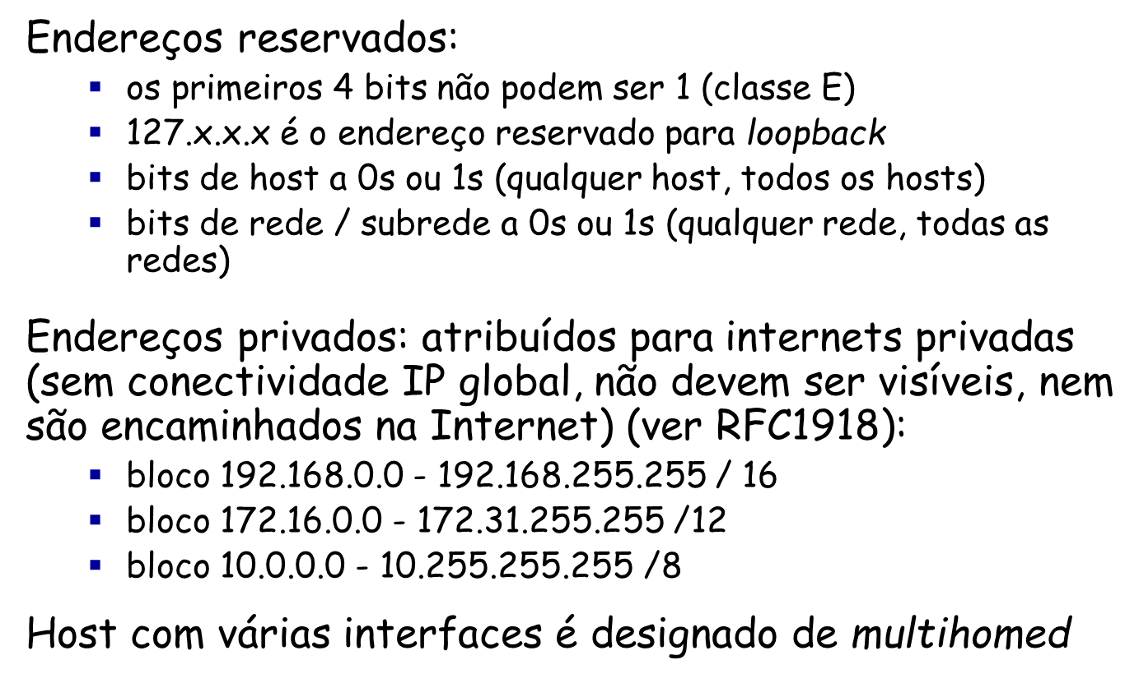
IP addressing: reserved/private addr
Network Layer
4-<number>

Slide 39
IP addressing: reserved/private addr
Endereços para configuração dinâmica do Link-Local:
  O bloco 169.254.0.0 /16 está reservado para comunicação entre estações ligadas ao mesmo meio físico nas seguintes condições:
  Quando um interface não foi configurado com um endereço IP, nem manualmente nem por uma fonte na rede (ex: DHCP) a estação pode configurar automaticamente o interface com um endereço IPv4 de prefixo 169.254.0.0/16 (RFC 3927)
  Algoritmo:
    Gera um endereço aleatório uniformemente distribuído no intervalo [169.254.1.0 , 169.254.254.255]
    Envia ARP-request com endereço de destino igual ao gerado (probe)
    Se houver ARP-reply então repete 1. porque há colisão de endereço
    Senão anuncia endereço gerado através de um ARP-announcement
Network Layer
4-<number>

Slide 40
IP addresses: how to get one?
Q: How does a host get IP address?
hard-coded by system admin in a file
  Windows: control-panel->network->configuration->tcp/ip->properties
  UNIX: /etc/rc.config
DHCP: Dynamic Host Configuration Protocol: dynamically get address from as server
  “plug-and-play”
Network Layer
4-<number>

Slide 41
IP routing: introduction
Tanto os routers como as estações, possuem uma tabela de encaminhamento
As entradas na tabela incluem:
  1ª coluna: Endereço da Rede de destino (mais máscara)
  2ª coluna: Endereço IP da interface de entrega (next hop)
  N coluna: Identificador da interface de saída da máquina local
  colunas opcionais: flags, tráfego no interface, custo, etc.
A entrega (forwarding), ou salto (hop) seguinte de um datagrama IP, é decidida em função do endereço IP destino do datagrama
MIEI-RC
Universidade do Minho

Slide 42
IP routing: introduction
Exemplo: tabela de encaminhamento da estação 192.110.1.240
  > netstat -nr
  destination next_hop netmask flags use interface
default 192.110.1.254 0.0.0.0 UG 102410 tu0
192.110.1.0 192.110.1.240 255.255.255.0 UH 234576 tu0
....... ...... ……. ....... ...... .......
192.168.1.0 192.110.1.253 255.255.255.0 UG 124586 tu0
Leitura da última linha:
Um datagrama destinado à rede 192.168.1.0 será entregue na interface de endereço 192.110.1.253 saindo pela interface local tu0
Qual a topologia de rede que se pode inferir da tabela?
MIEI-RC
Universidade do Minho

Slide 43
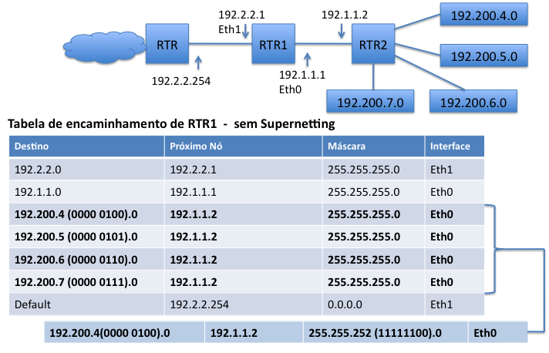
IP routing: supernetting
MIEI-RC
Universidade do Minho

Slide 44
IP routing: forwarding algorithm
Entrega (forwarding):
É facilitada pelo endereçamento hierárquico
O endereço IP é: a.b.c.d/m = X.Y (rede.estação)
  1) usar máscara para extrair o endereço de rede X
  2) procurar entrada que melhor se ajuste a X
  se X é local, entregar no interface X.Y (entrega directa)
  senão usar X para determinar o próximo salto (next hop);
  3) A entrada por defeito (0.0.0.0/0) ajusta-se a todos os X
MIEI-RC
Universidade do Minho

Slide 45
IP routing: static vs. dynamic
Encaminhamento (routing):
  a) Estático - baseado em rotas pré-definidas
    as rotas permanecem fixas
    reduz o tráfego na rede
    esquema simples mas pouco flexível
  b) Dinâmico - rotas atualizadas ao longo do tempo
    os routers trocam informação de routing entre si
    esta actualização dinâmica de rotas é obtida através de protocolos específicos de encaminhamento (routing):
        RIP, OSPF, BGP, etc.
    grande flexibilidade e adaptação (automática) a falhas ou mudanças na configuração de rede
    o tráfego de actualização pode causar sobrecarga na rede
MIEI-RC
Universidade do Minho

Slide 46
IP routing: default route
Caminho por defeito é a rota a seguir caso não exista uma entrada específica na tabela para a rede de destino
  é um caso particular de encaminhamento estático
  a rota por defeito tem prioridade inferior à das outras rotas
  é identificado pelo termo default ou pela rede 0.0.0.0
  permite reduzir a tabela de encaminhamento
Os protocolos de encaminhamento modelam a rede como um gráfo e calculam o melhor caminho para um dado destino
MIEI-RC
Universidade do Minho

Slide 47
IP routing: route computation
Computação dinâmica das rotas:
  centralizada - cada router, conhecendo a topologia da área, determina o melhor caminho para os possíveis destinos dessa área
  distribuída - cada router envia informação de encaminhamento que conhece aos routers seus vizinhos (redes a que dá acesso)
Princípio utilizado
  Vector Distância (Vector Distance)
    e.g. Routing Information Protocol (RIP), IGRP
  Estado das ligações (Link State)
    e.g. Open Shortest Path First (OSPF)
MIEI-RC
Universidade do Minho

Slide 48
IP routing: route computation
Um router pode conhecer rotas estáticas e/ou dinâmicas para um mesmo destino, aprendidas por protocolos distintos.
Como é seleccionada a “melhor” rota?
  distância – indicador administrativo que permite estabelecer uma relação de preferência entre rotas aprendidas por protocolos de routing distintos.
  métrica – indicador que traduz o custo de fazer forwarding por uma determinada interface, permitindo estabelecer uma relação de preferência entre rotas aprendidas pelo mesmo protocolo de routing.
MIEI-RC
Universidade do Minho

Slide 49
IP addresses: how to get one?
Q: how does network get subnet part of IP addr?
A: gets allocated portion of its provider ISP’s address space
ISP's block 11001000 00010111 00010000 00000000 200.23.16.0/20
Organization 0 11001000 00010111 00010000 00000000 200.23.16.0/23
Organization 1 11001000 00010111 00010010 00000000 200.23.18.0/23
Organization 2 11001000 00010111 00010100 00000000 200.23.20.0/23
... ….. …. ….
Organization 7 11001000 00010111 00011110 00000000 200.23.30.0/23
Network Layer
4-<number>

Slide 50
Hierarchical addressing: route aggregation
hierarchical addressing allows efficient advertisement of routing
information:
Organization 0
200.23.16.0/23
Organization 1
200.23.18.0/23
“Send me anything
with addresses
beginning
200.23.16.0/20”
Organization 2
200.23.20.0/23
.
Fly-By-Night-ISP
.
.
.
.
Internet
Organization 7
.
200.23.30.0/23
ISPs-R-Us
“Send me anything
with addresses
beginning
199.31.0.0/16”
Network Layer
4-<number>

Slide 51
Hierarchical addressing: more specific routes
ISPs-R-Us has a more specific route to Organization 1
Organization 0
200.23.16.0/23
“Send me anything
with addresses
beginning
200.23.16.0/20”
Organization 2
200.23.20.0/23
.
Fly-By-Night-ISP
.
.
.
.
Internet
Organization 7
.
200.23.30.0/23
ISPs-R-Us
“Send me anything
with addresses
beginning 199.31.0.0/16
or 200.23.18.0/23”
Organization 1
200.23.18.0/23
Network Layer
4-<number>

Slide 52
Chapter 4: outline
4.1 introduction
4.2 virtual circuit and datagram networks
4.3 what’s inside a router
4.4 IP: Internet Protocol
  datagram format
  IPv4 addressing
  ICMP
  IPv6
4.5 routing algorithms
  link state
  distance vector
  hierarchical routing
4.6 routing in the Internet
  RIP
  OSPF
  BGP
4.7 broadcast and multicast routing
Network Layer
4-<number>

Slide 53
ICMP: internet control message protocol
used by hosts & routers to communicate network-level information
  error reporting: unreachable host, network, port, protocol
  echo request/reply (used by ping)
network-layer “above” IP:
  ICMP msgs carried in IP datagrams
ICMP message: type, code plus first 8 bytes of IP datagram causing error
Type Code description
0 0 echo reply (ping)
3 0 dest. network unreachable
3 1 dest host unreachable
3 2 dest protocol unreachable
3 3 dest port unreachable
3 6 dest network unknown
3 7 dest host unknown
4 0 source quench (congestion
control - not used)
8 0 echo request (ping)
9 0 route advertisement
10 0 router discovery
11 0 TTL expired
12 0 bad IP header
Network Layer
4-<number>

Slide 54
Traceroute and ICMP
source sends series of UDP segments to dest
  first set has TTL =1
  second set has TTL=2, etc.
  unlikely port number
when nth set of datagrams arrives to nth router:
  router discards datagrams
  and sends source ICMP messages (type 11, code 0)
  ICMP messages includes name of router & IP address
when ICMP messages arrives, source records RTTs
stopping criteria:
UDP segment eventually arrives at destination host
destination returns ICMP “port unreachable” message (type 3, code 3)
source stops
3 probes
3 probes
3 probes
Network Layer
4-<number>

Slide 55
IPv6: motivation
initial motivation: 32-bit address space soon to be completely allocated.
additional motivation:
  header format helps speed processing/forwarding
  header changes to facilitate QoS (Quality of Service)
IPv6 datagram format:
  fixed-length 40 byte header
  no fragmentation allowed, by default
Network Layer
4-<number>

Slide 56
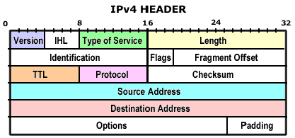
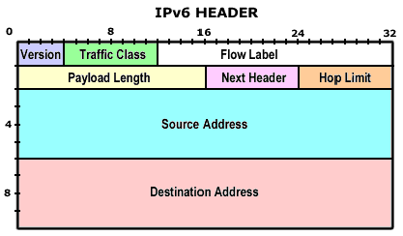
IPv6 datagram format
Moving to a simpler header...
Network Layer
4-<number>

Slide 57
IPv6 datagram format
priority (traffic class): set priority among datagrams in flow
flow Label: identify datagrams in same “flow.”
(concept of “flow” not well defined).
next header: identify upper layer protocol for data
ver
pri
flow label
payload len
next hdr
hop limit
source address
(128 bits)
destination address
(128 bits)
data
32 bits
Network Layer
4-<number>

Slide 58
IPv6: other changes from IPv4
checksum: removed entirely to reduce processing time at each hop
options: allowed, but outside of header, indicated by “Next Header” field
ICMPv6: new version of ICMP
  additional message types, e.g. “Packet Too Big”
  multicast group management functions
Network Layer
4-<number>

Slide 59
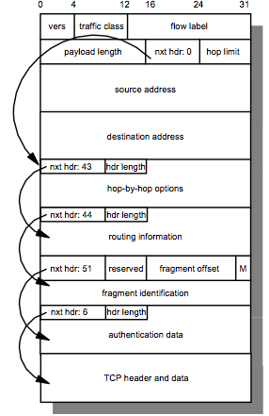
IPv6: other changes from IPv4
The field next header (equivalent to “Protocol” in IPv4) is used to implement specific options
Example of an IPv6 packet including multiple headers
Network Layer
4-<number>

Slide 60
IPv6: adoption
US National Institutes of Standards estimate [2013]:
  ~3% of industry IP routers
  ~11% of US gov’t routers
Long (long!) time for deployment, use
  20 years and counting!
  think of application-level changes in last 20 years: WWW, Facebook, …
  Why?
  Things are changing…
Network Layer
4-<number>

Slide 61
IPv6: State of deployment 2018
Since the World IPv6 Launch (2012), levels of IPv6 deployment in networks and service providers all over the globe have increased considerably.
Over 25% of all Internet-connected networks advertise IPv6 connectivity.
Google reports 49 countries deliver more than 5% of traffic over IPv6, and 24 countries whose IPv6 traffic exceeds 15%.
Major mobile networks are driving IPv6 adoption. In Japan (NTT – 7%, KDDI – 42% and Softbank – 34%), India (Reliance JIO – 87%) and the USA (Verizon Wireless – 84%, Sprint – 70%, T-Mobile USA – 93%, and AT&T Wireless – 57%).
IPv6 is moving from the “Innovators” and “Early Adoption” stages of deployment to the “Early Majority” phase.
(Source: Internet Society https://www.internetsociety.org/resources/2018/state-of-ipv6-deployment-2018, November 2018)
Network Layer
4-<number>

Slide 62
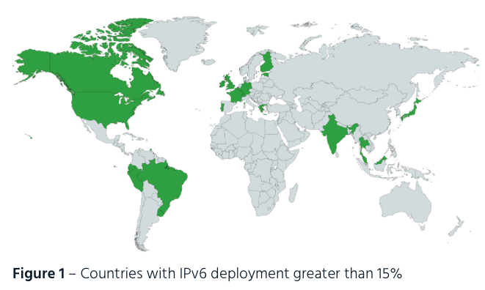
IPv6: State of deployment 2018
(Source: Internet Society https://www.internetsociety.org/resources/2018/state-of-ipv6-deployment-2018, November 2018)
Network Layer
4-<number>

